Slide 1
30200 Project: How Remote Work Policy Influences Job Interview Behaviors
May 18, 2022
Zhe Zhang

Slide 2
Project Overview
Goal
- Examining the impact of remote work on interview questions.
Why should we care?
Provide guidance for job search
No studies based on interview questions
Notes:
Since the epidemic, many industries have faced a whole new set of challenges, both in terms of maintaining customer relationships and in terms of shifting collegiality due to social distance restrictions. In response to the problems caused by social distance restrictions, many companies have implemented remote working policies. Whether such policies in turn affect companies' recruitment strategies will be investigated in depth in this paper.
We have witnessed the wave of unemployment and the increased difficulty of employment since the epidemic, and the analysis on company recruitment strategies can be a good guide for future job seekers.
According to the literature review done previously, there is no analysis based on big data about company interviews. And they all used questionnaires.

Slide 3
Literature Review
A pessimistic attitude towards the unknown
-- Vijayan et al.
A whole new challenge of relationship with customers.
-- Donovan
The company is more looking for people with team cohesion and leadership to join.
-- Zimmermann et al.
While some will be uncomfortable, others will release more optimistic signals as a result of working remotely.
-- Chen, Liu, Tang, & Hogan
Notes:
Based on a summary of the relevant literature, we can obtain the following information.
Based on a questionnaire survey of Vijayan et al. with a large number of employment officers as well as job-seekers and HR in India. vijiayan et al. found that the unknown nature of the new crown epidemic has led to a very pessimistic future outlook among job-seekers, and employment officers and HR have had to make adjustments to their recruitment strategies because of the new crown epidemic. The direction of the adjustment is unknown, as the impact of the new crown cannot be estimated in a short period of time. The overall interviewees showed a pessimistic attitude.
The PwC survey by Donovan et al. also revealed that a large portion of the firm believes that the social restrictions imposed by the epidemic are making it more difficult to maintain relationships with clients.
At the same time, of course, some research teams have found that some people will be more comfortable working remotely. Because they don't have to work face-to-face, it reduces the stress in their workplace lives.
And more companies also tend to look for people with more leadership and affinity as new members of the team.

Slide 4
Research Question
Do remotework systems have an impact on the questions asked in company interviews, if so, in what ways?

Slide 5
Research Methods
Bag of Words
Word Frequency / Day (standardized)
The trend of interview questions is known by the change of word frequency/day.
Notes:
Using the method of bag of words, extract the word frequency of the words in the corresponding time period (before covid occurrence, occurrence-remote policy on, after on)
Get the word frequency/valid days, and the valid days are the occurrence interviews of that day.
The rate of change of this word frequency is compared, and the words whose absolute value of change exceeds a certain threshold are extracted and a picture is generated to get their trend.

Slide 6

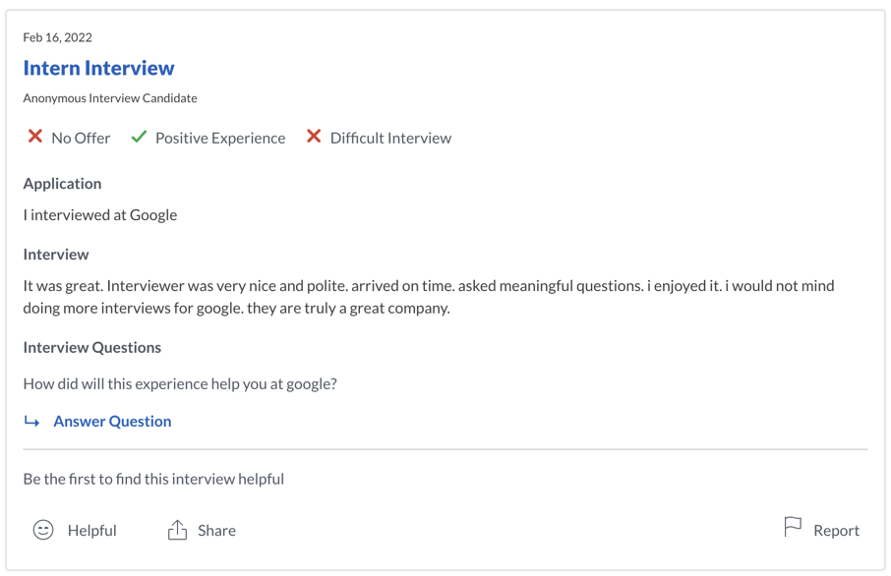
Data
Source - : find interview questions
Didn’t use existing statistics as we seek to analyze something new
Company name → Interviews → Interview & interview questions
Interview | InterviewQuestions | date
multi level interviews, done over zoom, with many teams involved. Behavior interview questions, focused on how I approached scenarios. Focused on my skill set and experiences. Friendly interviewers, good feedback given during and after. | Describe a difficult scenario you encountered and how you handled it? | 2022-04-25
remote interview with no technical question. General university experience and scenario based questions. Overall 30 minute interview and got feedback within 1 week after the interview and offer after 3 months . | Name a time you were project leader ? | 2022-04-25
1. Phone interview 2. Interview - Two MDs interviewed me. 3. On-site Invitation - Presentation about my work - 10+ 30-min interviews with MDs - Lunch with associates - Dinner with MDs | - Specific questions about my research - What's your view about shareholder activists? - How would you advise our clients about the threats of shareholder activists? | 2022-04-24

Slide 7
Data
Company choose
Standard & Poor 500
Financials and Services
Consumer Discretionary and Traditional
Communication and High Tech
Sample Size
- Data entry: each targeted post on Glassdoor
- From 2009/3/11 to 2019/12/31: 87k
- From 2020/1/1 to 2020/6/1: 34k
- From 2020/6/1 to 2022/5/1: 49k
Notes:
Companies are classified according to the official S&P 500 classification.
Divided into 3 broad categories as shown below. For each of these three industries I extracted 9 companies based on the ranking.
All interview data of these companies were extracted for analysis and the total amount of data was at 170k.

Slide 8
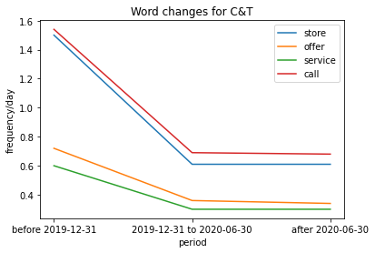
Findings: Data Analysis
Consumer Discretionary and traditional
Notes:
First, as the images we obtained show, remote work policies do affect companies' hiring strategies. For different industries, the impact is reflected in different ways. As a direct result of the word frequency analysis, for traditional industries, the frequency of words like "offer" and "store" fell off a cliff, meaning that these words were rarely mentioned in interviews. The reasons for this event are also obvious; the ban on home due to the epidemic and the shakeup of the real economy on which the traditional industry is based are largely responsible for this.

Slide 9
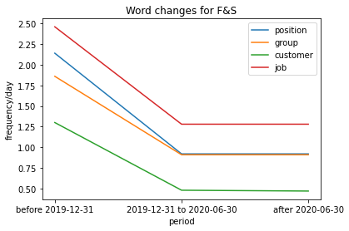
Findings: Data Analysis
Financials and Services
Notes:
In addition, the response from the financial services industry was expected, with words like "job" and "customer" declining in frequency to varying degrees. This is also related to the volatility in the financial market brought about by the downward spiral of the economy in the context of the epidemic. And in times of economic chill, there are correspondingly fewer quality customers, and similarly fewer jobs to be absorbed by the financial sector.

Slide 10
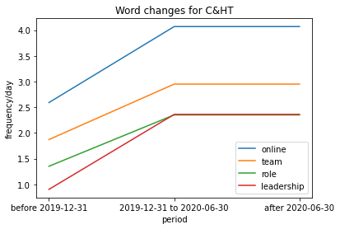
Findings: Data Analysis
Communication and High Tech
Notes:
In contrast, although Internet companies were also affected by the epidemic, the trend of change was significantly different, and it can be said that the word frequency of Internet companies generally showed an upward trend." Online; team; role; leadership" are all words that have a very clear rise. In contrast, although Internet companies have also been affected by the epidemic, the structure of the industry has changed, as evidenced by the strong increase in the frequency of words such as online, team and leadership. To some extent, Internet companies are experimenting with a new model of hiring. That is, the job situation, with group work and online work as the main orientation, is developing well in Internet and information companies. This is inextricably linked to the fact that Internet companies do not rely on the way of working with people face to face. And Internet companies have always given people a more chill impression, so leadership and approachability are also important considerations for companies in the post-epidemic era.

Slide 11
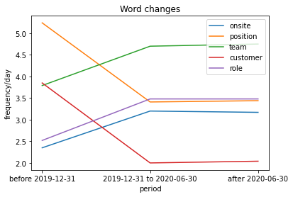
Findings: Overall Analysis
Notes:
In general, if you want to get better interviews in the post-epidemic era. Based on the results of the analysis of the whole company, you should give good consideration to the role you play in the team and try to integrate into the work group.

Slide 12
Discussion/Conclusion(s)
Conclusion
The remote working system did influences the questions ask during the company interview
Discussion
Consider the role you play in the team and try to fit in with the work group
The interview situation in the Internet industry is better than other industries.
Notes:
teleworking does have a significant impact on companies' hiring patterns, and this impact is reflected differently in different industries. For traditional and financial industries, remote working has had more of a negative impact, while for the Internet industry, due to the nature of the work of Internet companies, it has had more of a positive boost.

Slide 13
Limitations & Future Research
Limitations
Control variable problem
Future Research
Model training
Declined Offer | Neutral Experience | Average Interview
good | bad | bad
good | good | neutral
bad | good | neutral
bad | neutral | neutral
bad | good | bad
bad | good | neutral
good | good | neutral
good | good | neutral
bad | good | neutral
Notes:
Limitations. Control principle problem: We do not have access to interview data "without the impact of remote" (after the epidemic, almost all companies have initiated/forced to open online office programs). Therefore, we cannot use the comparison method to get a more intuitive conclusion that "remote's work policy did influence the company's recruitment strategy”
In my data I still have some unused data after label, I can train an interview result prediction model in combination with my interview question to better help job seekers find jobs.

Slide 14
References
Vijayan, Jaya, Dona Anice Siby, and Govind PV Sabeen. "Impact of Covid-19 Pandemic on Recruitment Process and its Sentiment Analysis." In 2021 2nd International Conference on Advances in Computing, Communication, Embedded and Secure Systems (ACCESS), pp. 270-273. IEEE, 2021.
Zimmermann A, Ravishankar MN. Collaborative IT offshoring relationships and professional role identities: Reflections from a field study. Journal of Vocational Behavior. 2011;78(3):351–360.
Y. Chen, D. Liu, G. Tang, T.M. Hogan, Workplace events and employee creativity: A multi-study field investigation, Personnel Psychology (2020)
Donovan, A. (2019). What PwC Learned from Its Policy of Flexible Work for Everyone. Retrieved July, 26, 2020.
P. Kilgour, D. Reynaud, M. Northcote, C. McLoughlin, K.P. Gosselin, Threshold concepts about online pedagogy for novice online teachers in higher education, Higher Education Research & Development, 38 (7) (2019), pp. 1417-1431,10.1080/07294360.2018.1450360

Slide 15
THANK YOU FOR LISTENING!
Zhe Zhang

